Slide 1
FS– SAP Industry Accelerator
MCS - Democratizing Digital

Slide 2


Table of Contents
Guiding Principles
End Goal and Outcomes
Solution Architecture
Data Model & Entity Mapping
Technical Architecture

Slide 3
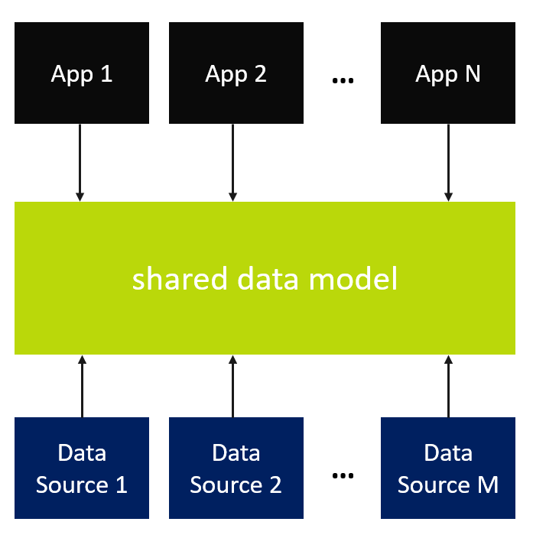
Guiding Principles
Objectives & Guiding Principles:
Lead with Business Value for customers and SIs
Align with Microsoft approach of creating similar Industry Accelerators
Leverage and extend the work done by Community
Streamline distribution of the IP/Content
Extensible Architecture - Start with Utility (SAP/FS), extend for additional SAP/FS (and Dynamics) workloads
Digital Feedback Loop for customer data
Shared Data Model
N apps built over shared entities + M data integrations to the entities
Shared Data Model with rich semantics

Slide 4

Our Approach
Approach:
Create Utility (SAP/FS) Industry Accelerator as baseline solution with the ability for ISVs and SI to extend
Published on Git Hub – Measure effectiveness and get community feedback
Customers
SI
SIs: Package together ISV solutions and customize to deliver
AppSource
AppSource: Delivery mechanism for Industry Solutions and/or Apps and Microsoft Solution Accelerators
3rd Party Connectors
ISV
ISV
ISV
ISV
Industry ISV
Industry ISV
Industry ISV
Industry ISV Solution: may stand alone or OEM other industry or horizontal apps
ISV
ISV
Microsoft Utility (SAP/FS) Solution Accelerator
Microsoft Industry Solution Accelerators: package of data model, relevant business processes, Power BI dashboards, and sample data
Microsoft Standard CDM
Notes:
Deliver Industry standard CDMs and accelerator packs for prioritized industries. data model, pre-configured dashboards, workflow processes and sample data to get you started.

Slide 5
Solution Architecture – Open Data Initiative
Open Data Initiative:
Align with Open Data Initiative
Leverage CDM folders and Extend for Azure Data Lake Gen 2
Adobe
Customer Experience Platform
…
Microsoft
Dynamics 365
SAP
SAP C/4HANA and SAP S/4HANA
…
AI driven insight & data enrichment
Shared data model
a
e
c
One data model
d
b
f
Common data storage
Azure Data Lake Storage
Notes:
This is what ODI looks like:
A foundation of a single data storage. All desired customer data natively flows into this data lake – focused on Analytics data, with the ability to pull in transactional data
As data flows into the storage, a single, shared data model organizes the data and makes it useable for, data enrichment, creating a unified profile, etc
With that in place, native applications can pull in desired data or entities, such as customer profiles to take action
Transition: This can apply to any customer use case

Slide 6








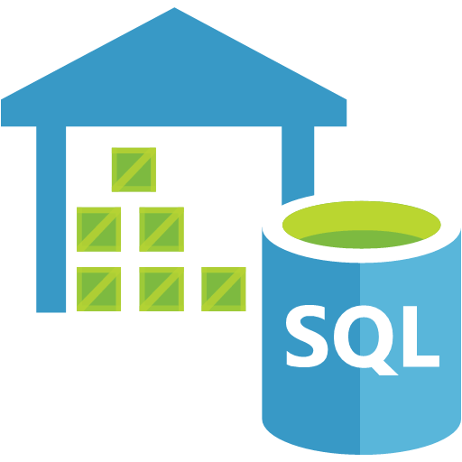

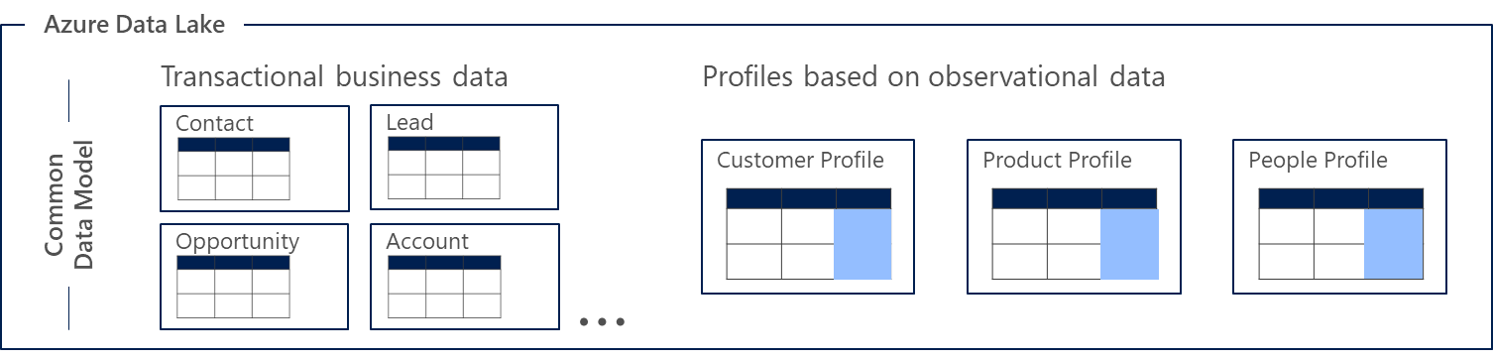
Solution Architecture – Conceptual View
https://aka.ms/cdm
Dynamics FS and SAP ISU to share CDM
FS and ISU to have workload specific entity model extension
CDS to be leveraged for seamless data exchange (to be reviewed by team)
Office 365
Dynamics Field Service
SAP
Power BI
Azure IoT
Azure Data Services
data ingest, data prep, AI, machine learning, data warehousing
ISU
Common Data Service
Power BI
dataflows
Azure Data Lake Storage
CDM folders

Slide 7
Solution Architecture – Industry Accelerator Domain Model
Customer Collaboration
Account Management
Account
Address
Contact
Work Order Management
Work Order
Booking
Bookable Resource
Service Task
Incident
Product
Equipment
Business Master Data Management
Business Partner (Account)
Business Partner Address
Contract Account
Contract
Meter and Device Management
Device Data
Device Installation
Device Inspection
Case Management
Case
Activities
Service Management
Notification
Service Order
Technical Master Data Management
Connection and Connection Object
Premise
Installation
Point of Delivery (PoD)
Device
Device Location
Plant Maintenance
Notification
Service Order
Equipment
Functional Location
Asset Management
Customer Asset
Asset Sub Component
Agreement Management
Agreements
Contracts
D365 Field Service
SAP IS-U and PM
Analytics and Reporting

Slide 8
Industry Accelerator – Entity Relationship Model
SAP IS-U Business Master Data Management
Contract Account (BCONT)
Contract (EVER)
SAP IS-U Service Management
Notification
Service Order
SAP IS-U Technical Master Data Management
Connection and Connection Object
Premise
Installation
Point of Delivery (PoD) (EUILNR)
SAP Plant Maintenance
Equipment (EQUI)
Functional Location (IFLOT)
Business Partner (BUT00, BUT050)
Business Partner Address (ADRC)
Device Location
Device (EASTL)
SAP IS-U Meter and Device Management
Device Data (EGER*)
D365 Work Order Management
Work Order
Booking
Bookable Resource
Equipment
Incident
Product
Service Task
D365 Account Management
Account
Address
Contact
Account Hierarchy
Device Installation
Device Inspection
D365 Asset Management
Customer Asset
Asset Sub-Component
D365 Agreement Management
Agreements
Contracts
Internal Entities
Relationship in SAP
D365 Case Management
Case
Activity
NOTE: This is a representation of corresponding LEADING business entities in each system.
Not all objects need full synchronization and differs based on project requirements.

Slide 9







Reference Process Flow - Meter to Cash
Dynamics
SAP R/3, ECC, S4HANA
Customer Service
Accounts
Service Tickets
Self-Service
Maintenance requests
Service
Management
Notifications
Service Order
SAP IS-U
SAP PM
Consumer
Scheduling
Routing
Dispatch
Installation
Repair
Collect Payment
Field Operations
Case or
Work order
Device Data Management
Master Data Management
Installation
Smart Meter
Meter Reading
Data Validation
Exception Management
Installation
Inspection
Manage Technical Master Data
Manage Business Master Data
Analytics & Preventive Maintenance
SAP FI/CA
Billing
Credits & Collection

Slide 10
Industry Accelerator – Logical Data Model
Business entities, organized into modules such as Core (CDM), Dynamics and SAP ISU
These entities are representations of commonly used concepts (i.e. Account) and are extensible
Each entity has a set of attributes and metadata (including semantic metadata)
Entities may have relationships to 0-N other entities
Core (CDM)
Account
Dynamics
SAP
Contact
Address
FS
Service
BCONT
ISU
PM
Email
Work Order
Case
Business Partner Address
Notification
Notification
Asset
Scheduling
Contracts
Service Order
Maintenance Order
Activity
Product
Bookings
Service Activity
Connection Object
Note
EVER
Functional Location
Customer Assets
Work Order
Device
Contracts
Equipment

Slide 11
Logical Data Model - Entity Inheritance
Entities can be extended with additional attributes in subsequent modules. The subsequent entity is inherited from the ones above. This allows modules to build on existing concepts while adding new attributes specific to that business.
For example:
the Dynamics model extends Account to include openCases, actualRevenue, territoryId
SAP - ISU extends it further adding payableAccountNumber
Core
Dynamics
SAP
Account
accountId
accountNumber
accountRatingCode
createdOn
creditLimit
…
Account
accountId
accountNumber
accountRatingCode
createdOn
creditLimit
openCases
actualRevenue
territoryId
…
Account
accountId
accountNumber
accountRatingCode
createdOn
creditLimit
PayableAccountNumber
…

Slide 12

Entities, Attributes, Traits
Entities are common concepts such as Account or Contact. Entities have specific semantics and can be related to other entities.
Each standard entity has a set of well-defined attributes. These attributes contain data about aspects of the entity.
Additional metadata called traits can be applied to entities, attributes, relationships etc. that provide semantic meaning.
CDM (Core) includes a set of standard entities, attributes and traits for easy reuse and interop across applications.
CDM Core
Account
Description: Business that represents a customer or potential customer
Attributes:
accountId
accountRatingCode
address1City
creditLimit
name
…
Contact
Description: Person with whom a business unit has a relationship, such as customer.
Attributes:
contactId
accountId
birthDate
company
department
…
Accounts
Fabrikam Redmond, WA
Litware Sydney, AU
Alpine Ski Paris, FR
Contoso London, UK

Slide 13

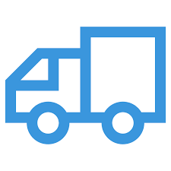



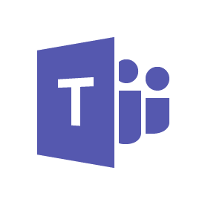



Reference Technical Architecture
Power Platform
Microsoft Dynamics 365
UCI/Unified Service Desk
Data Export Service
Power Apps
Flow
Power BI
Planning
Reactive Work Order
Assessment
Contact
Connected
Field Service
Customer Insights
Marketing
Scheduling
Planned Reactive Work Order
Planned Preventative Work Order
Triage & Collaboration
IOT
Alerts
Microsoft Azure
Data Synchronization
Analytics
Forecast
Data Factory
Asset Info
Other Customer
Information
Other Billing
Information
SAP Connector
Other Asset
Information
Customer Info
Mobile
Data Gateway
Geo Spatial Visualization
Contractor Payments
Billing
Notifications &
Work Orders
Asset
[MASTER]
Customer and Property
[MASTER]
Red Line
* Logic App - SAP Connector

Slide 14
Industry Accelerator - Integration Rationale
Business Scenario
Practices and Patterns
Event-Driven Consumer
Technology Options
Multiple options can be considered to accommodate the underlying integration needs
Flow, Logic Apps, Web Services, Azure Service Bus, SSIS, BizTalk, etc.
Remote Procedure Invocation
3. Publish-Subscribe
5. Relay
6. Presentation Integration
SAP and other line of business applications will need to be integrated into Dynamics (FS)
Evaluate the integration strategy
Conclusion
The use of Publish-Subscribe as the best practice & pattern
Logic Apps and the SAP Connector as the main driver for the integration
4. Data Exchange
Accommodate the underlying Integration requirements in the value proposition as an Industry accelerator
grounded on MSFT best practices and
patterns:
Event Grid or Azure Service BUS to enable the transport/orchestration of messages
Azure Service Bus and Logics Apps will provide the Dynamics integration with the LOB Applications leveraging the SAP Connector at an enterprise grade scale
Enterprise Integration Pack as the placeholder for the schemas and maps

Slide 15
Industry Accelerator: Integration Design Principles
Maximize the use of the Integration Platform
Design loosely coupled systems
Elastic Integration
Orchestrating the integration calls as part of business processes
Act as abstraction layer for different systems to communicate
Transformation of data
Broadcasting messages to different systems
Consolidation of messages and send one message to Dynamics
Integration platform as a trigger to pushing/pulling the data from Dynamics and other systems
Loosely coupled systems are less constrained to same platform, language, operating system
Error handling and Retries
The integration platform should be able to scale up and scale down resources on demand and on a need-to basis
Limit synchronous integrations
With synchronous calls, the client connection is opened till response is received and could make implementation at server end complex and potentially impact the user experience
Standardize Connectivity
Use the managed connectors or create a standardize custom connector using the pre-published API’s
Leverage the use of the available connectors, such as the SAP connector, where applicable
Secure Data
Batch load/pull scenarios
Secure data at:
Rest
In process
In transit
Web API/Rest endpoints for integrating with Dynamics
For batch load/pull scenarios ensure system performance is not impacted during peak hours
Schedule batch pull/push in off-peak hours to ensure optimal performance
Web API’s are standard and proven way to connect to Dynamics. It provides a modern, RESTful web services can be used to interact with data in Dynamics using a wide variety of platforms, programming languages and devices
Azure AD for authentication with Dynamics
Evaluate the ability to sync with Azure AD, which provides a SSO experience and also opportunity to use windows credentials for authentication and authorization in Dynamics
Minimise the use of Stubs during development and Testing
Stub based development could lead to quality issues and should be avoided

Slide 16
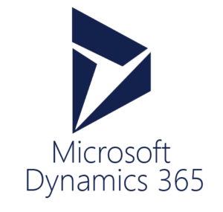




Dynamics to SAP
Outbound
(Service bus pattern)
Azure Cloud
4
Sync call to MSD
Azure Service Bus
Azure Logic App
Queue / Topic
Entity Message snapshot (Context)
DLQ
Azure Service Bus Listener
Generate Payload (schema mapping
Push to SAP through the SAP Connector
Event Create/Update/Delete
SAS
SAS
3
1
2
Sync call to SAP
Async
Async
Data Gateway & Nco 3.0
BAPI
IDoc
RFC
SAP
Pros
Dynamics has no reliance on external system to function
Good / common practice
Good user experience in Dynamics as the integration is performed asynchronously
Scalable and well resilient solution
Cons
Business user would not get the result immediately
Potential contention due to near-real time execution
Higher complexity than direct interface
Cost implication due to Azure components
Create
Update

Slide 17
Dynamics to SAP
Outbound
(Flow/Event Grid pattern)
Azure Cloud
4
Sync call to MSD
MS FLOW / Event Grid
Azure Logic App
Queue / Topic
Entity Message snapshot (Context)
Listener
Generate Payload (schema mapping)
Push to SAP through the SAP Connector
Event (trigger MS Flow) Create/Update/Delete
SAS
SAS
3
1
2
Sync call to SAP
Async
Async
Data Gateway & Nco 3.0
BAPI
IDoc
RFC
SAP
Pros
Dynamics has no reliance on external system to function
Good / common practice
Good user experience in Dynamics as the integration is performed asynchronously
Scalable and well resilient solution
Cons
Business user would not get the result immediately
Potential contention due to near-real time execution
Higher complexity than direct interface
Cost implication due to Azure components
Create
Update

Slide 18
Dynamics to SAP
Outbound
(Real-time pattern)
Azure Cloud
Azure Logic App (exposed endpoint)
HTTP Trigger
Entity Message snapshot (Context)
Push to SAP
SAP Connector
Event Create/Update/Delete
Sync
Sync
Data Gateway & Nco 3.0
BAPI
IDoc
RFC
SAP
Pros
Good / common practice
Real-time data flow
No Sandbox limitations as Azure Function is used
Cons
Dynamics has reliance on external system to function
Business users waiting time due to synchronous execution
Increased cost due to additional Azure component execution
Server-side performance impact
Display (Read)
Notes:
Any On-Premise inbound API interactions are executed through SML (Service Mediation Layer) authenticating using API Key presented in the heather of the http request

Slide 19
Working with Microsoft Services
Benefits
Solution input opportunity
Architecture expertise to help design your solution
Joint marketing and promotion available*
Take a role in shaping the Dynamics 365 solution supporting the global nonprofit sector and have early access to Microsoft Dynamics 365 Nonprofit Accelerator roadmap
Architecture and industry expertise for your organization during the design phase to ensure alignment to the data model and accelerator throughout the project
Microsoft and organization to develop marketing assets and content to promote the work and mission of organization that benefit both brands by showcasing the organization’s positive impact in the community
Requirements
Open for any version or product mix for D365 cloud-based solutions
Solution must use the Microsoft Dynamics 365 Utility Accelerator that includes the Common Data Model for Utility
Can be net new implementation, refactoring of an existing implementation, or a migration to cloud
Any geography
Any Microsoft partner

Slide 20
Value Proposition
Combines workloads from Dynamics FS and SAP ISU
Works with other solutions in your environment
Incorporates best practices from the sector
Delivers fast, secure access to program insights
Built on an open standard owned by the sector
Encourages innovation by software partners
Published by Microsoft services in consultation with Microsoft Engineering

Slide 21
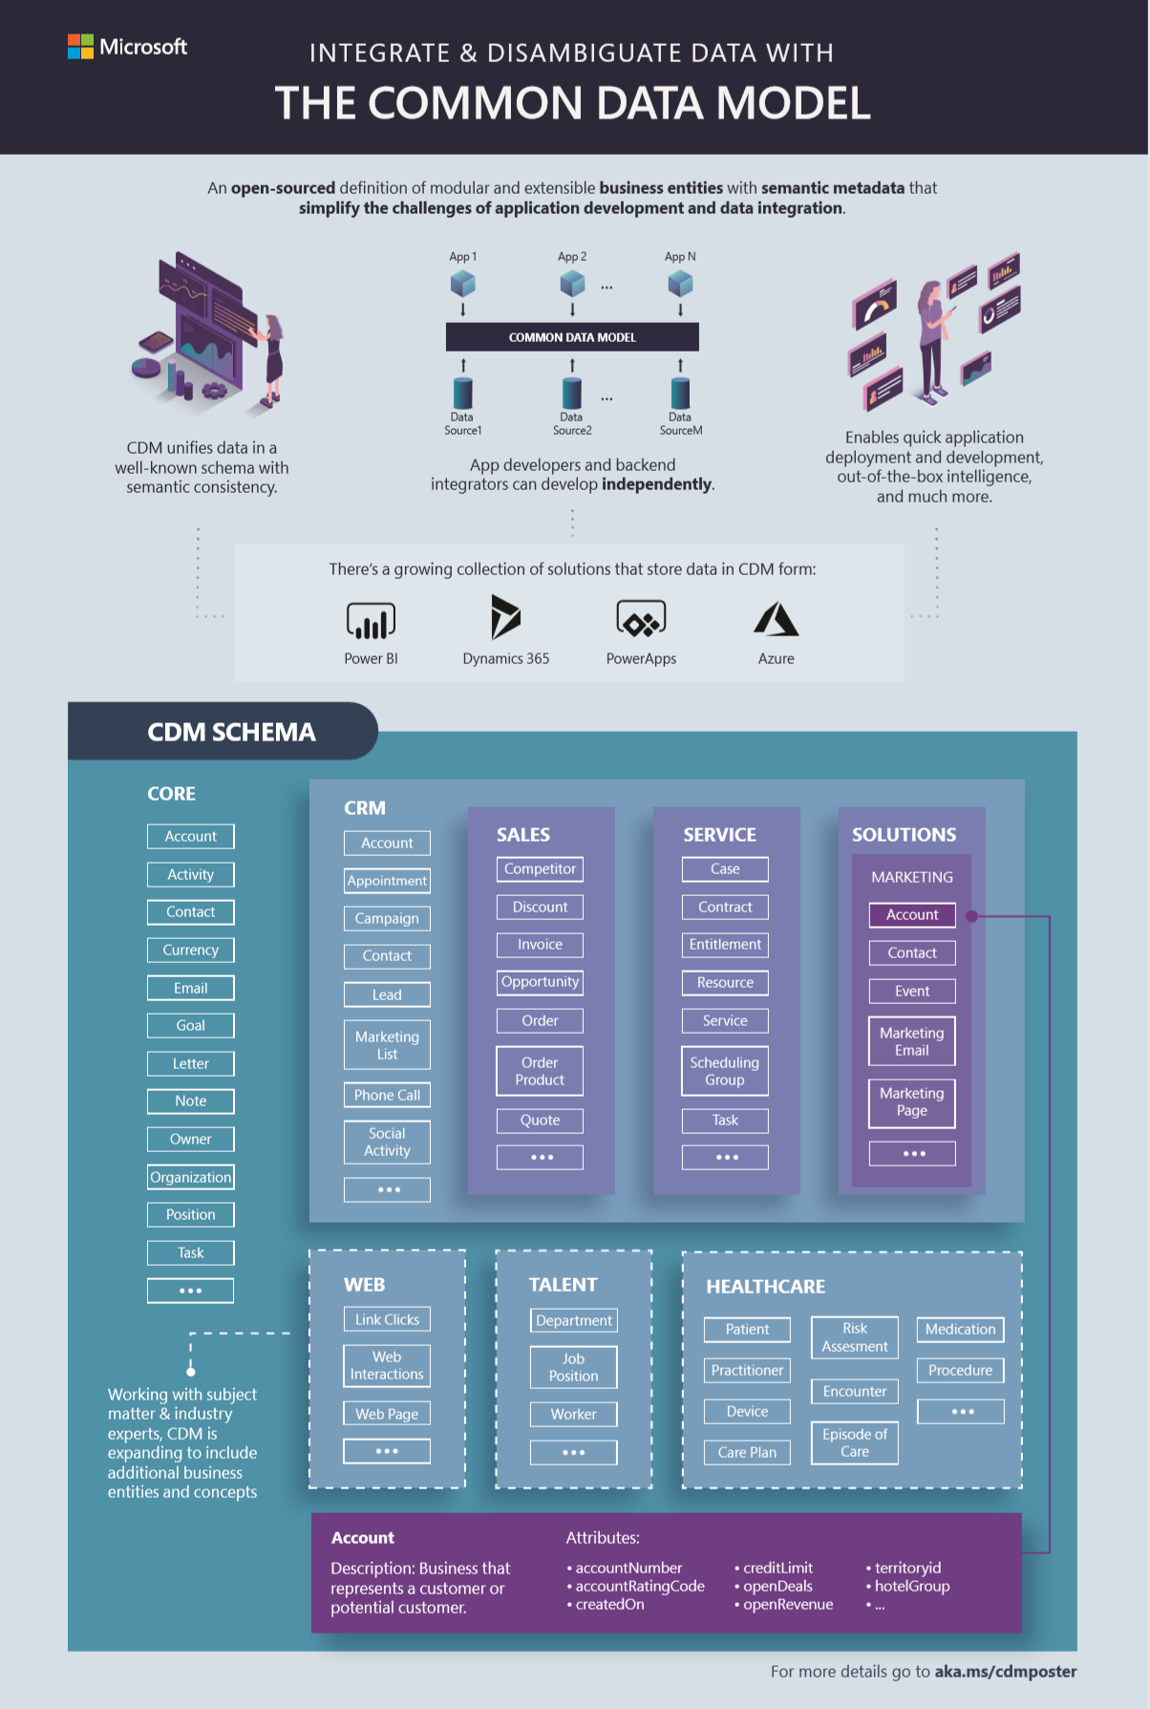
Common Data Model (CDM)
A shared data model allows applications and data integrators to more easily interoperate, by provided a unified definition of data
CDM includes a rich metadata system with standard entities, relationships, hierarchies, traits and more
Originated from Dynamics 365 / CRM apps, open-sourced in GitHub with over 260 standard entities
Ecosystem of internal and external partners contributing to the effort, including industry-specific concepts
Multiple systems and platforms implement CDM today
Internal and external partners including CDS for Apps, Power BI dataflows, Azure Data Services, Informatica and more

Slide 22
CDM Entities, Attributes, Traits
Entities are common concepts such as Account or Contact. Entities have specific semantics and can be related to other entities.
Each standard entity has a set of well-defined attributes. These attributes contain data about aspects of the entity.
Additional metadata called traits can be applied to entities, attributes, relationships etc. that provide semantic meaning.
CDM includes a set of standard entities, attributes and traits for easy reuse and interop across applications.
Core
Account
Description: Business that represents a customer or potential customer
Attributes:
accountId
accountRatingCode
address1City
creditLimit
name
…
Contact
Description: Person with whom a business unit has a relationship, such as customer.
Attributes:
contactId
accountId
birthDate
company
department
…
Accounts
Fabrikam Redmond, WA
Litware Sydney, AU
Alpine Ski Paris, FR
Contoso London, UK

Slide 23
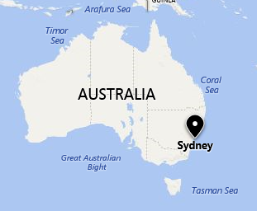
Traits & Semantic Metadata
Each entity, attribute and relationships can have additional metadata that better explains the meaning and intent of that object.
For example, from the CDM metadata applications can know “address1City” attribute is indicating a geographical location and can show the value on a map.
This metadata can also be used for intelligent actions, such as running sentiment analysis or language detection over a “surveyResponse” column.
Core
address1City
is.dataFormat.character
is.dataFormat.big
means.location.city
is.localized.describedAs
is.nullable
is.constrained
…
Account
Description: Business that represents a customer or potential customer
Attributes:
accountId
accountRatingCode
address1City
creditLimit
name
…
Accounts
Litware Sydney, AU Rating: 

